Slide 1

MAXWELL INTERNATIONAL PROJECTS BY AFOLABI OLUFUNSHO

Slide 2
Project Overview
Maxwell international is a company with three divisions i.e Hotel,Fintech, and Charity with visibility in five major countries (Nigeria,Ghana,Rwanda,United Arab Emirates and United Kingdom respectively. This project involves getting the rigth subbscription for each division,setting up varoius microsoft 365 services, and ensuring the enviroment is secure and efficient for each division,
Division details
Division 1: Hotel with 120 staff
Division 2: Fintech with 1500 staff
Division 3: Charity with 70 staff

Slide 3
CONTENT
Tools to be use to facilitate this project includes
1, Exchange online configuration
A) setting up mailboxes for each division
B)creating transport rules for email approval and restriction
2. Sharepoints
A)configuration of team sites and hubsites
B)Setting up list and migration
3) Entra ID
A)Setting up of administrative units
B)Creation of dynamic user groups
C) 2MFA updates and features
4) Microsoft teams configuration
A) creation of teams channel and breakout rooms
B) Intigrate project planning applications
5) Security and compliance policies and intune enrolment

Slide 4
Phase 1: Subcription for each division of maxwell international
Subscription for Hotel division with 120 staff
1.Microsoft 365 business standard
2.Microsoft 365 business premium
3.Microsoft 365 F3
Subscription for fintech group with 1500
1.Microsoft 365 E3(enterprise plan)
2.Microsoft 365 E5(enterprise plan)
3.Microsoft 365 F3(Frontline workers)
Subcription for Charity division with 70 staff
1.Microsoft 365 business basic
2.Microsoft 365 business standard\
3

Slide 5
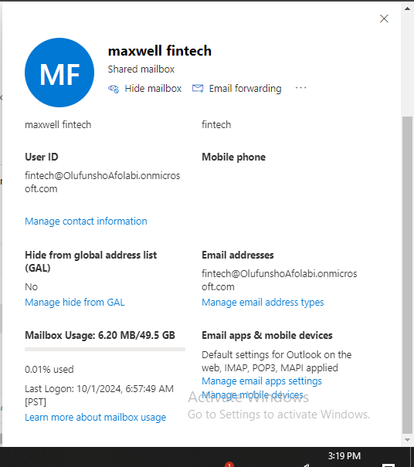
Maxwell fintech email configuration

Slide 6
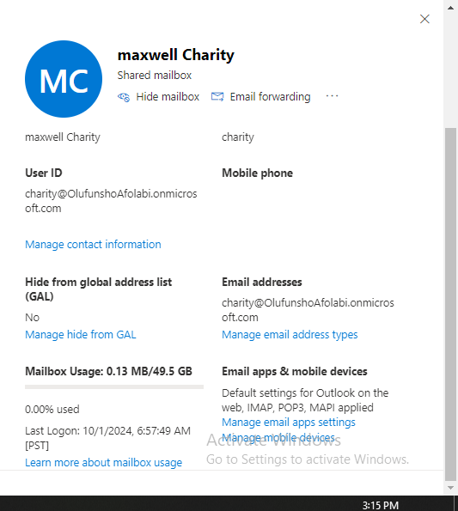
Exchange online configuration for the 3 divisions
Maxwell charity email configuration

Slide 7
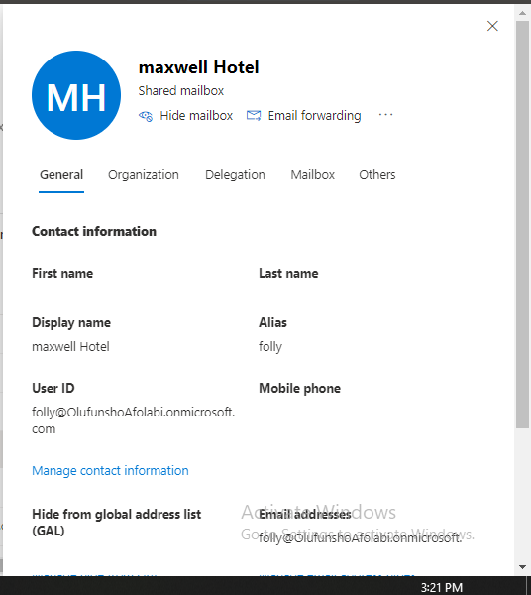
Maxwell hotels email configuration

Slide 8
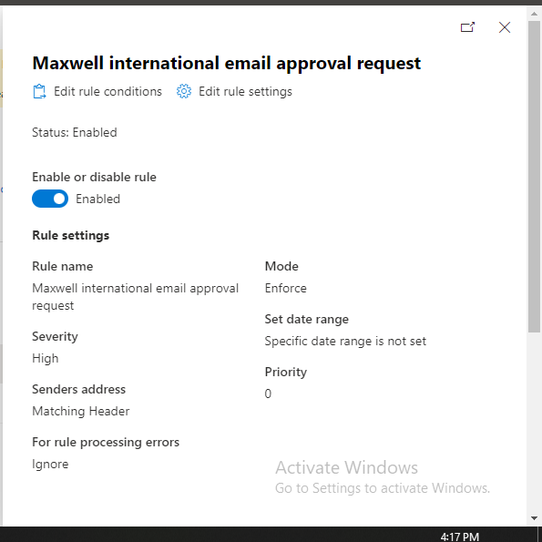
Maxwell International Email Approval Request

Slide 9
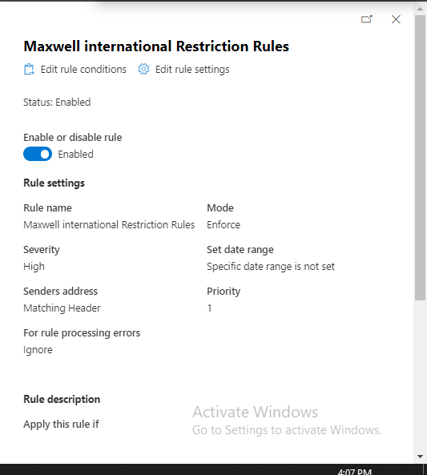
Maxwell international email restriction rule

Slide 10
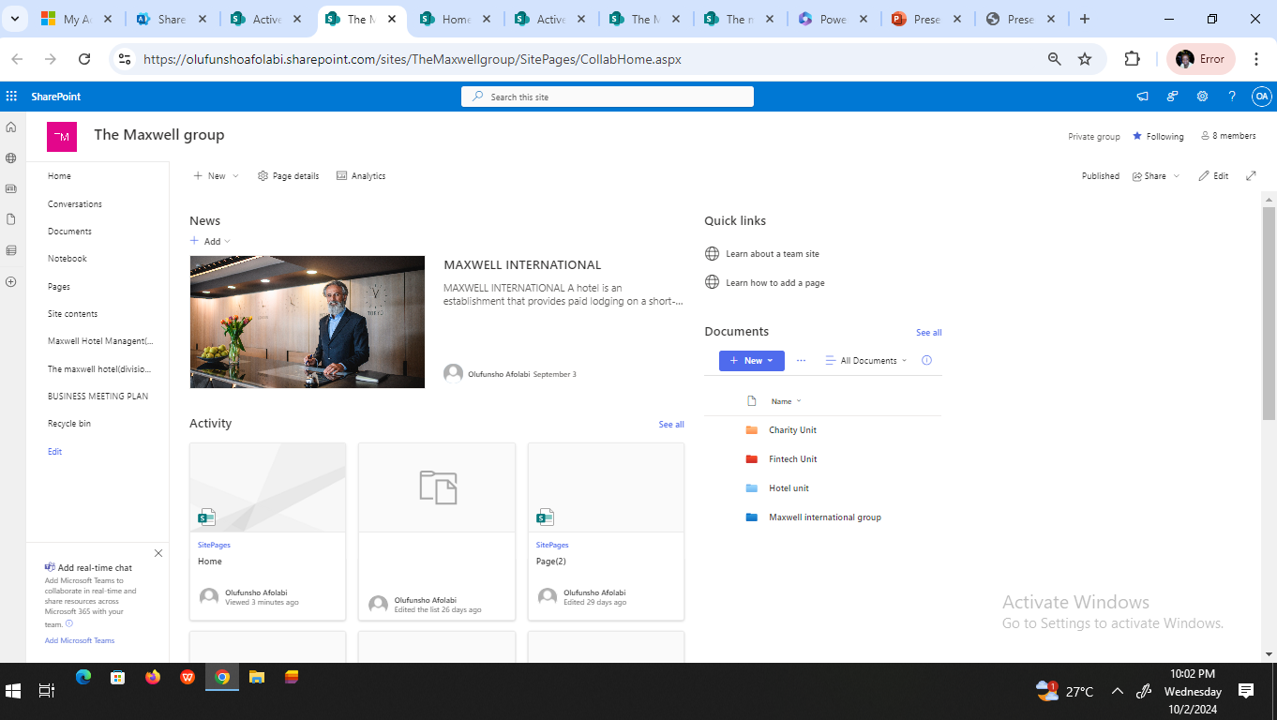
Maxwell International Team Site

Slide 11
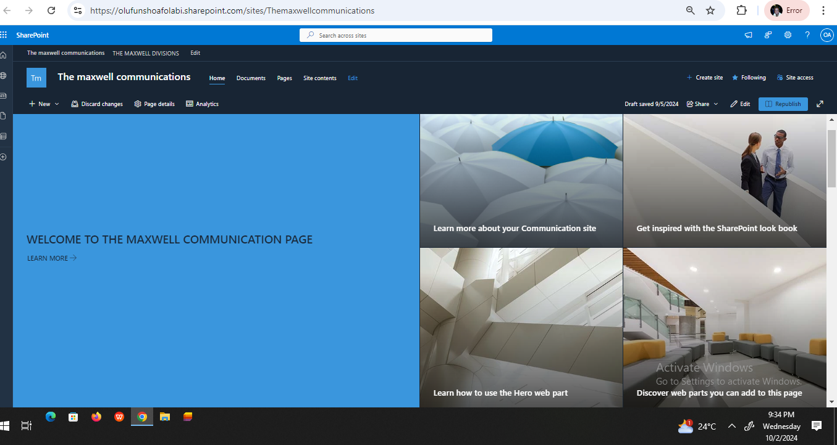
The maxwell International Hubsite

Slide 12
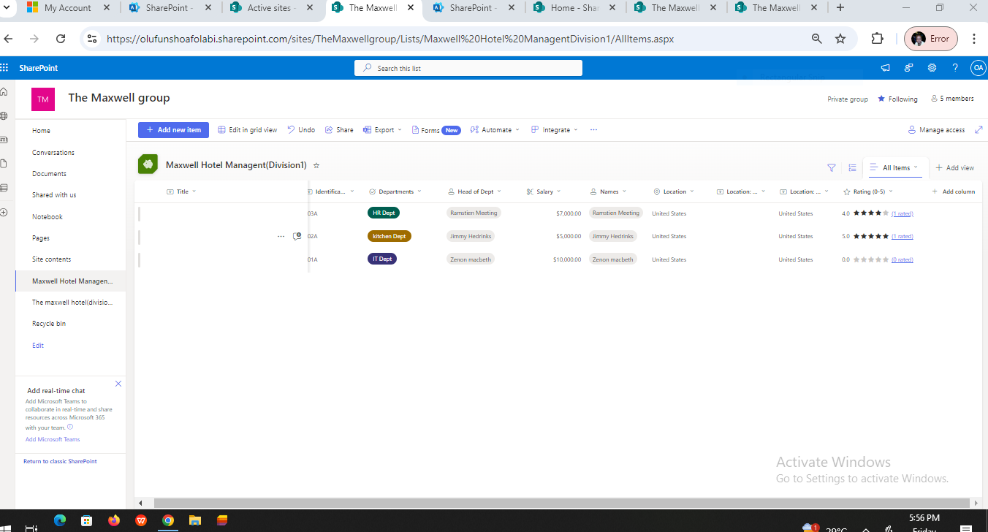
Maxwell International list

Slide 13
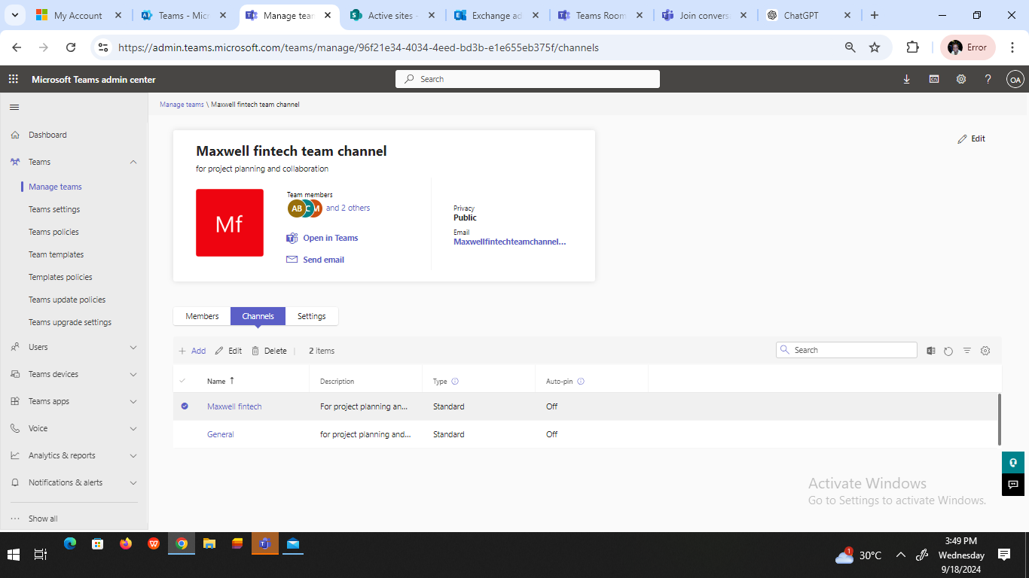
Maxwell charity teams channel

Slide 14
Maxwell fintech teams channel

Slide 15
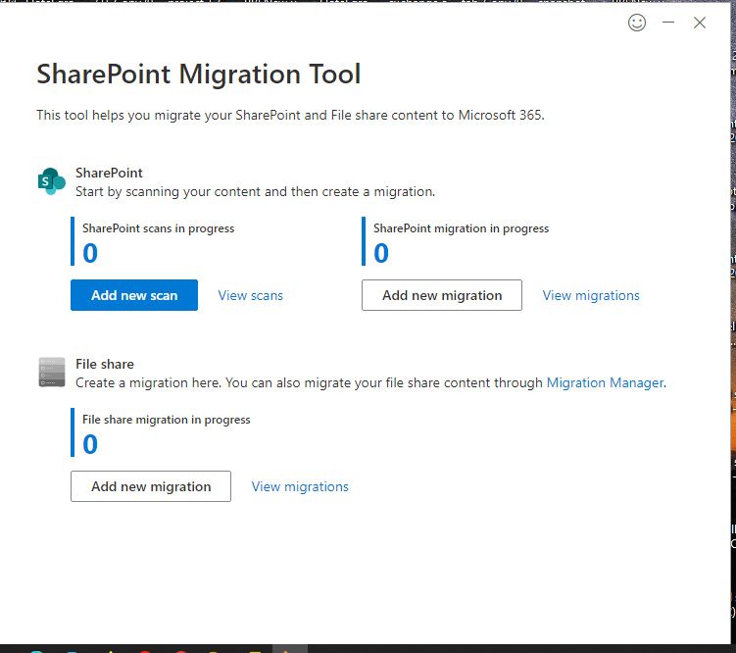
Migration tool

Slide 16
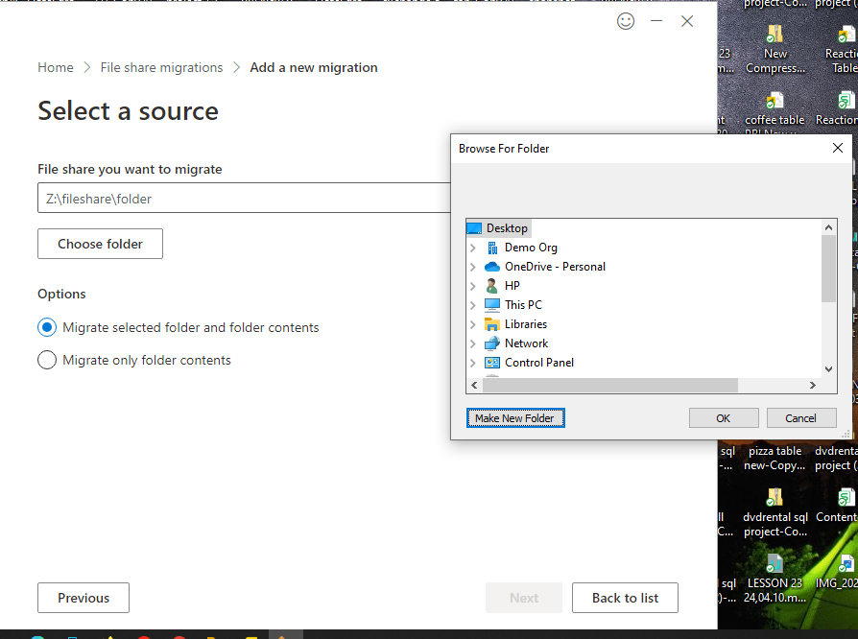
Sharepoint online migration process

Slide 17
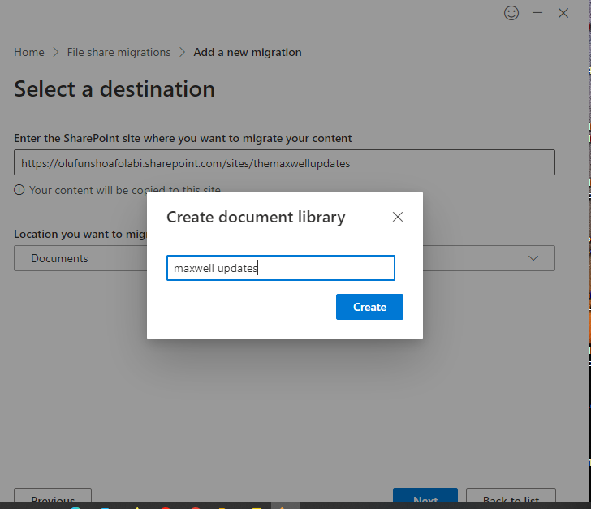
Migration process

Slide 18
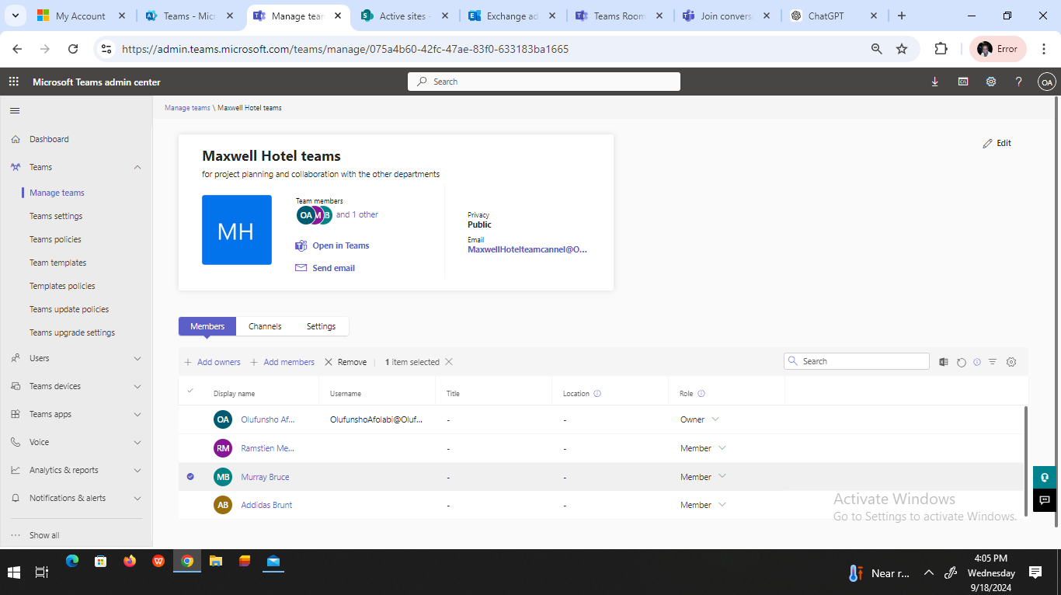
Maxwell Hotel Teams Channel

Slide 19
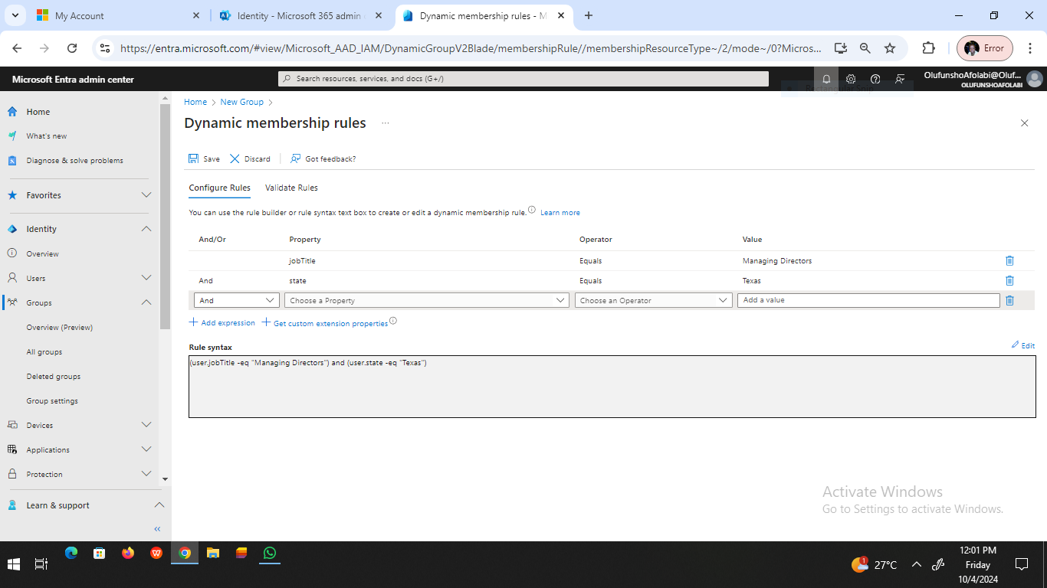
Dynamic membership rule

Slide 20
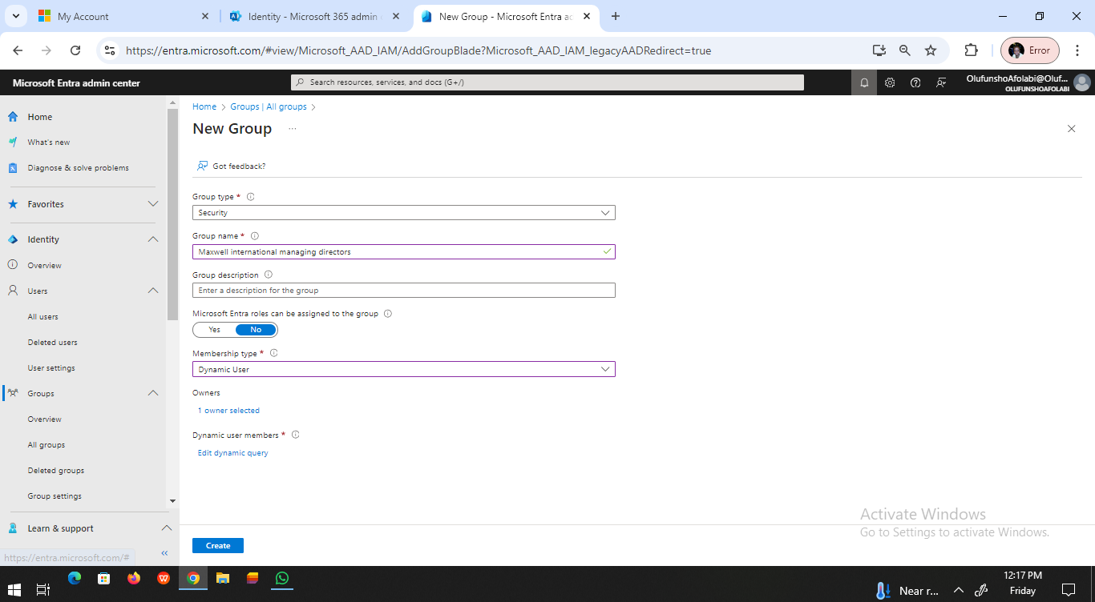
Dynamic user configuration

Slide 21
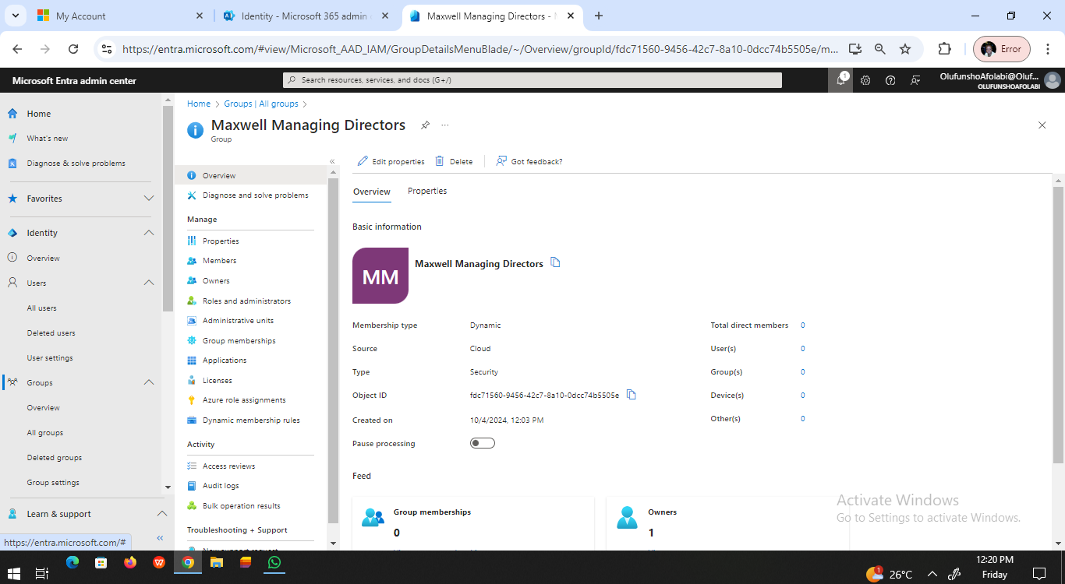
Dynamic user configuration

Slide 22
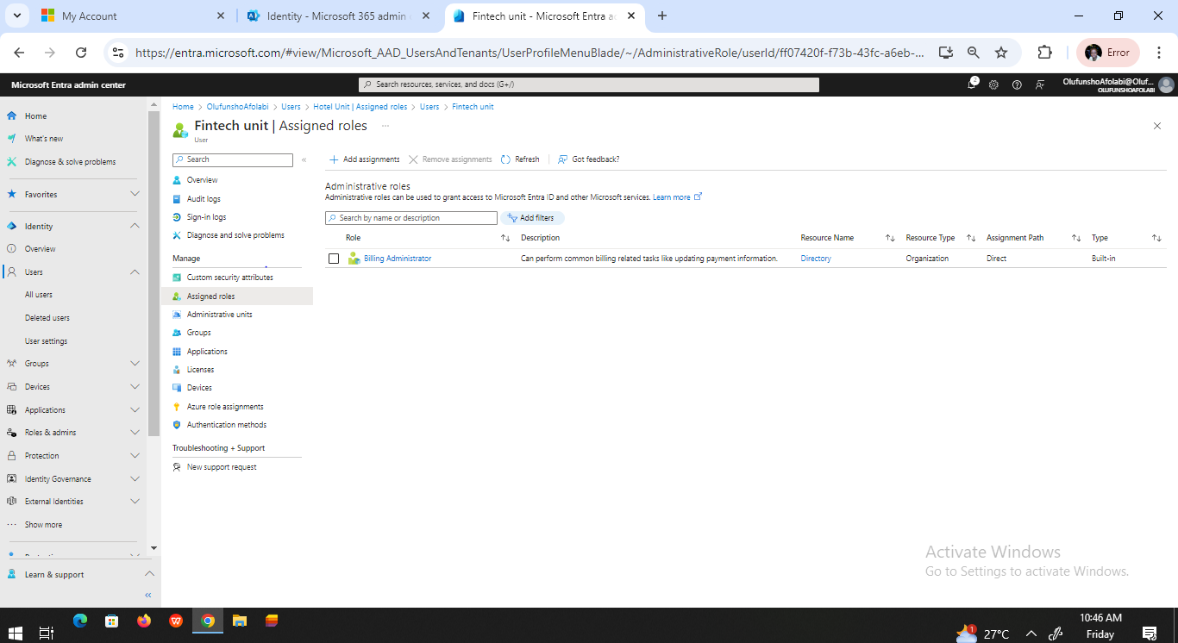
Entra ID Fintech Unit/administrative role

Slide 23
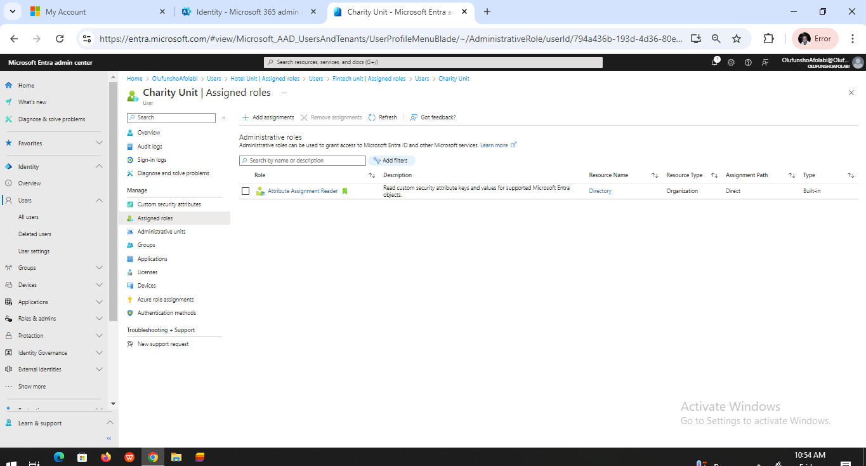
Entra ID Charity Unit/Administrative Role

Slide 24
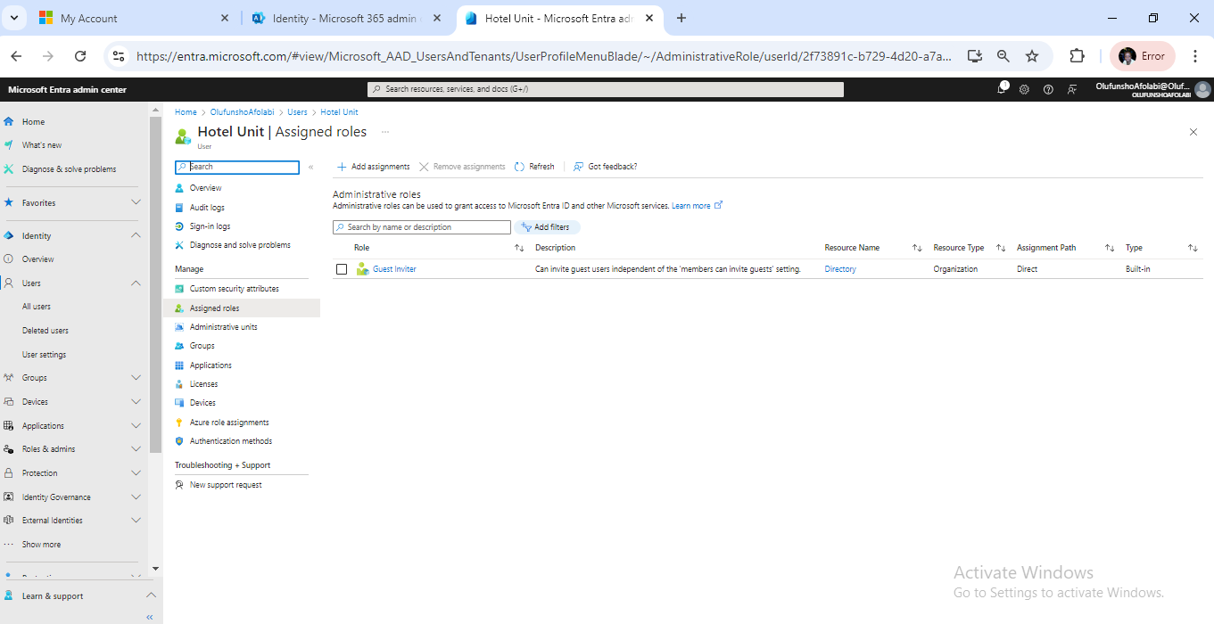
Entra ID Hotel Unit/Administrative role

Slide 25
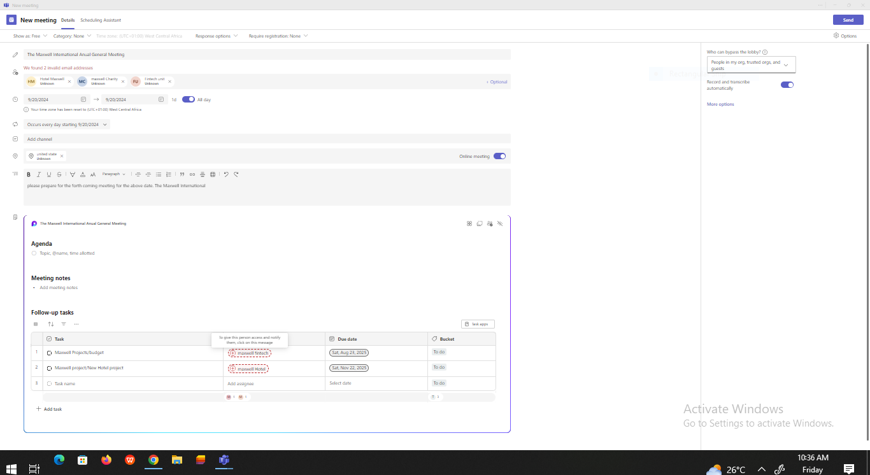
Breakout Room

Slide 26
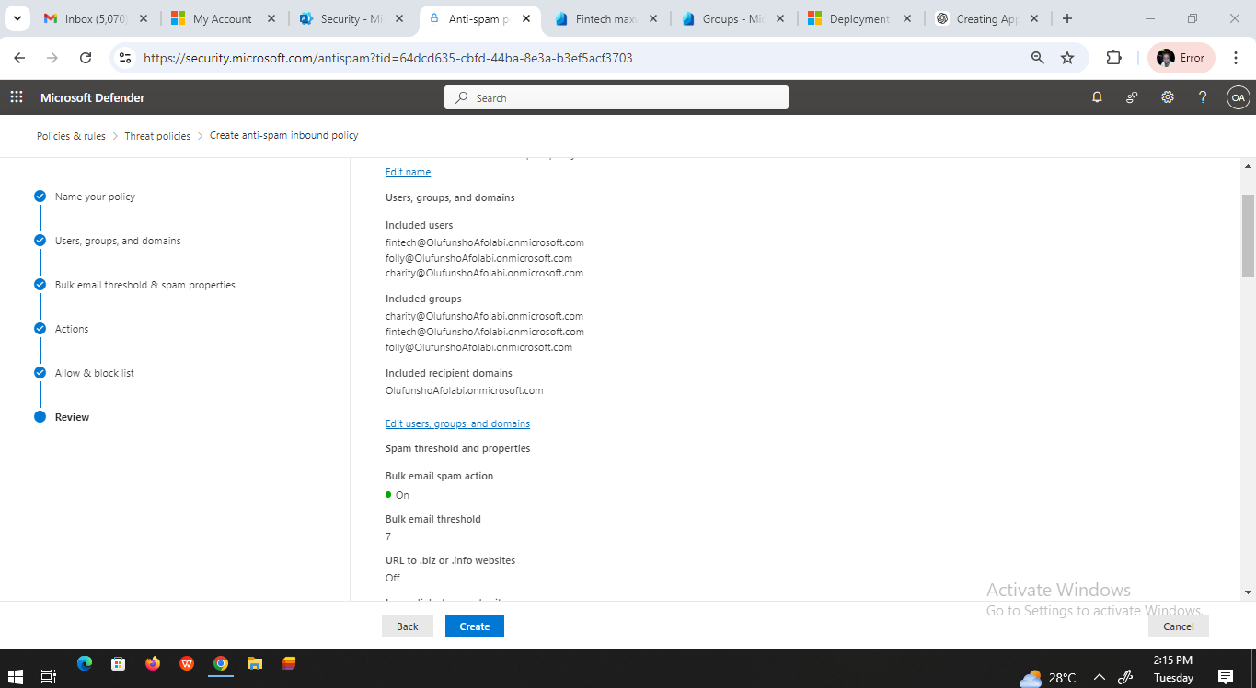
Compliance Policy/Antispam

Slide 27
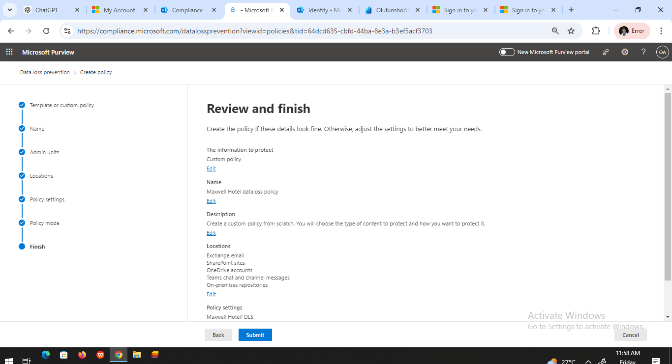
Security and Compliance/DLP policies

Slide 28
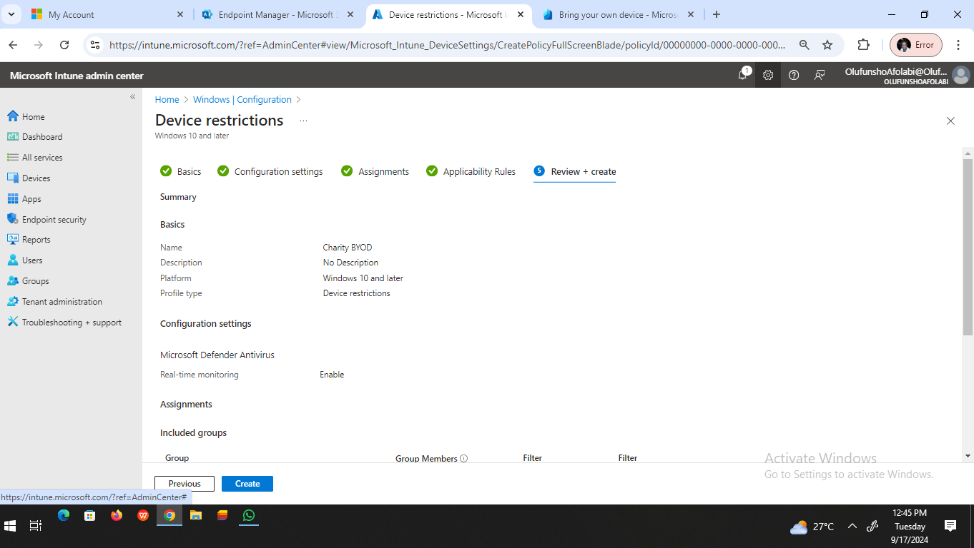
BYOD Charity Device Restriction

Slide 29
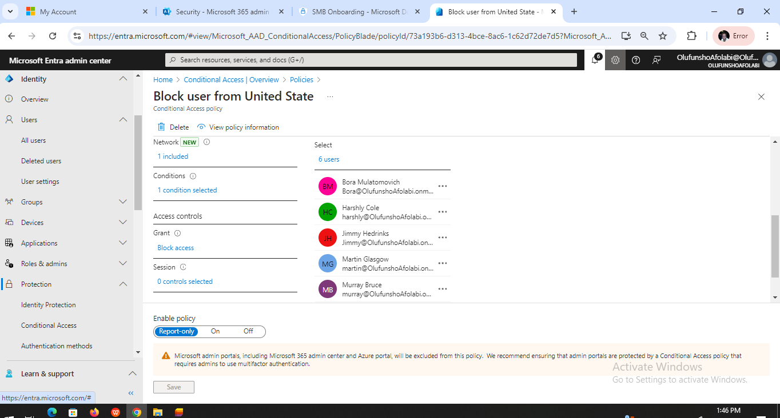
Conditional access blocking users from united state

Slide 30
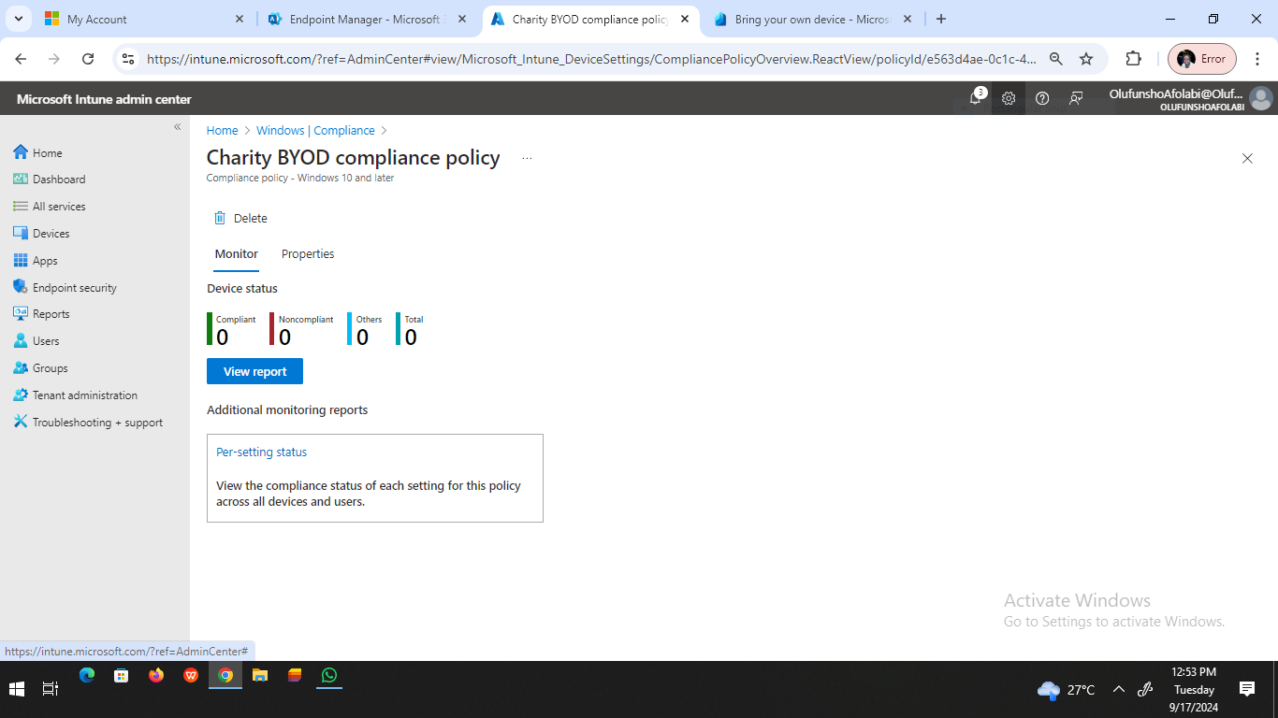
Charity BYOD Compliance Policy

Slide 31
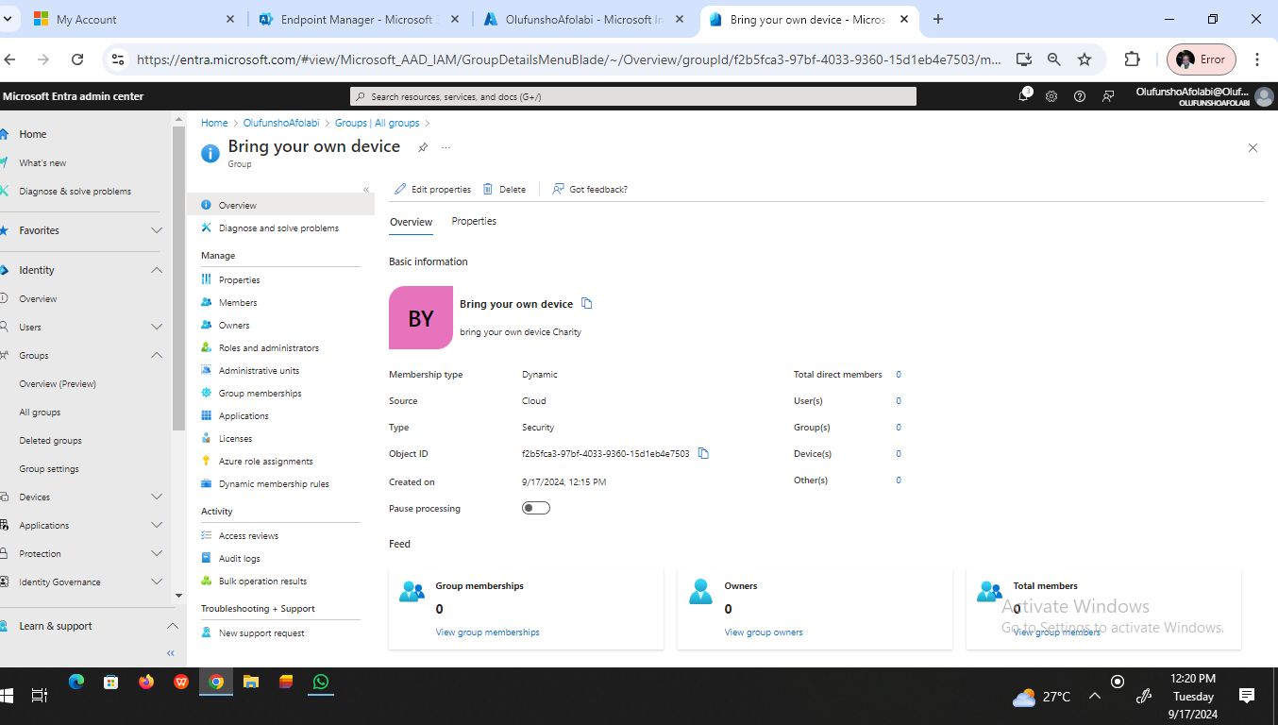
BYOD Overview

Slide 32
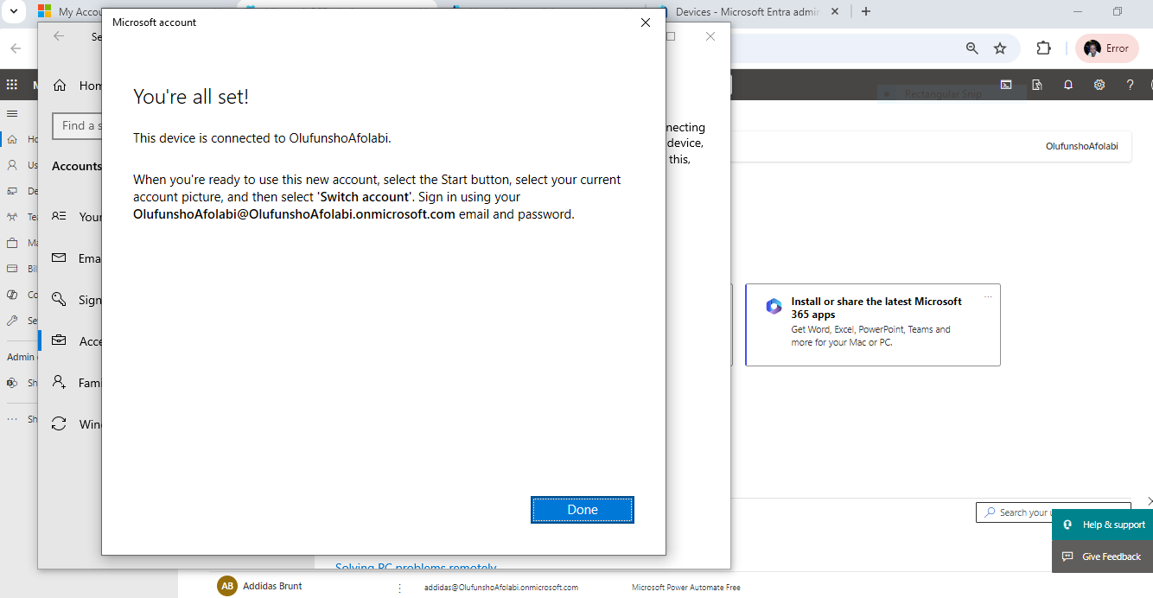
Device enrolment

Slide 33
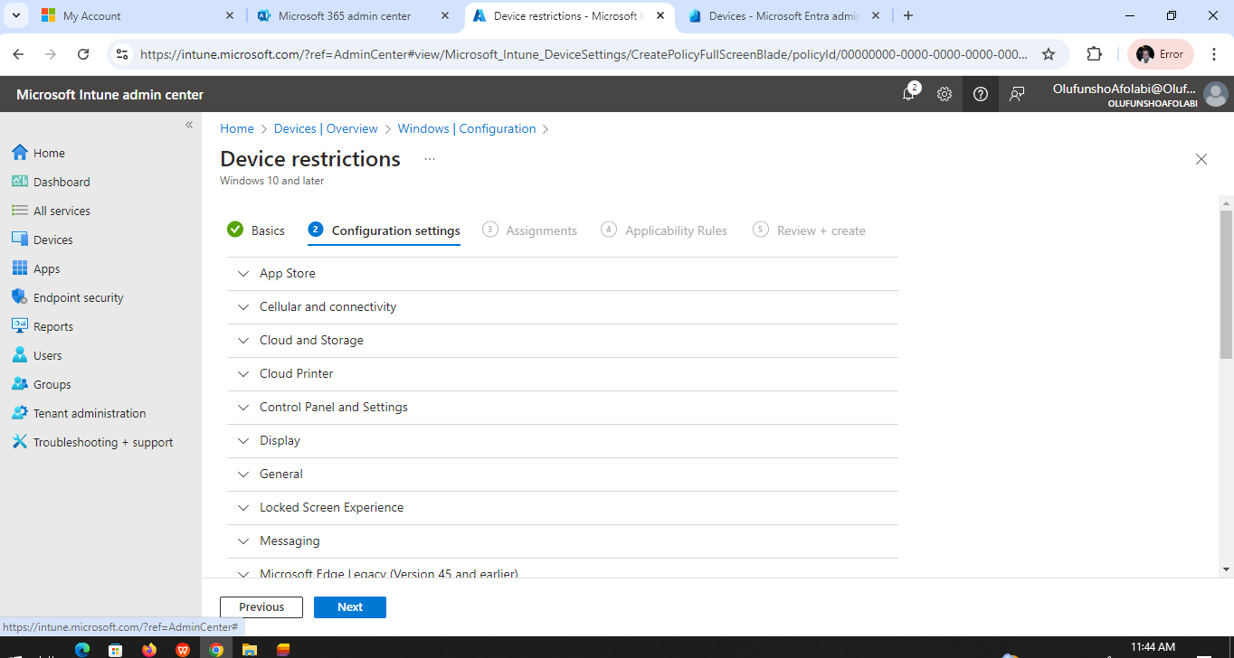
Device Restriction for Maxwell Hotel

Slide 34
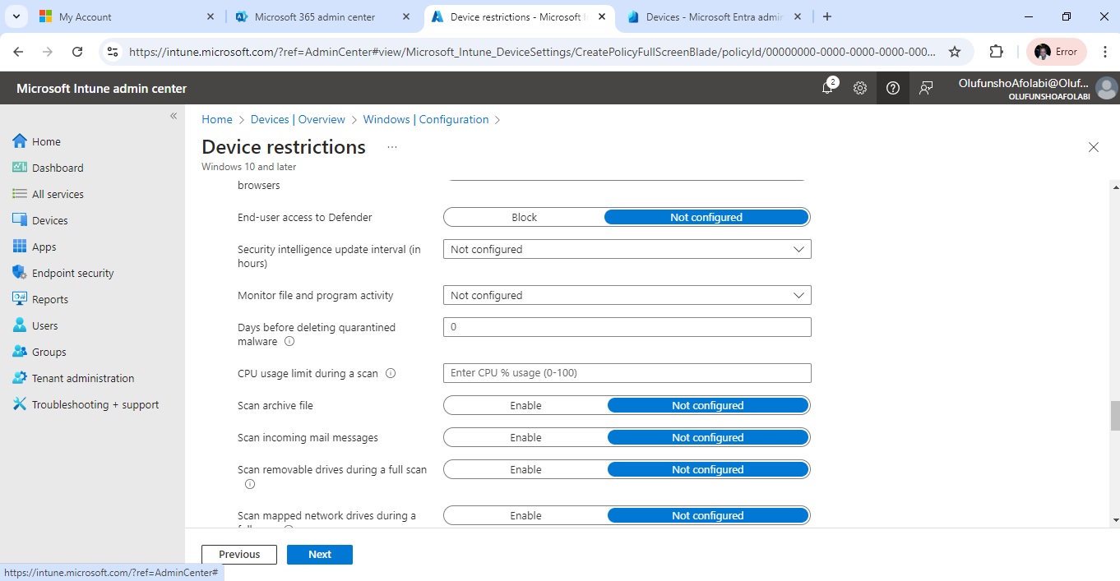
Maxwell Hotel Device Restriction

Slide 35
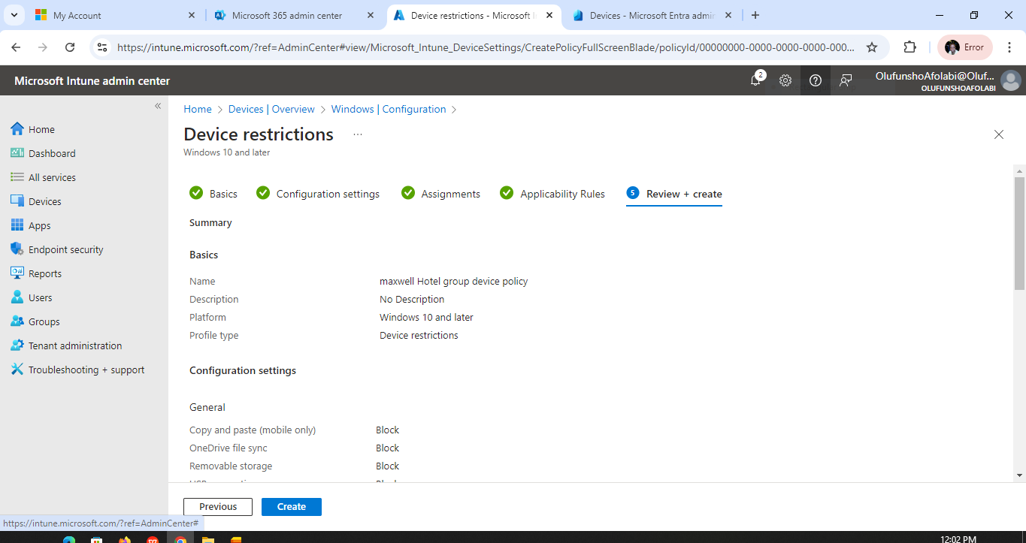
Maxwell Hotel Device Restriction

Slide 36
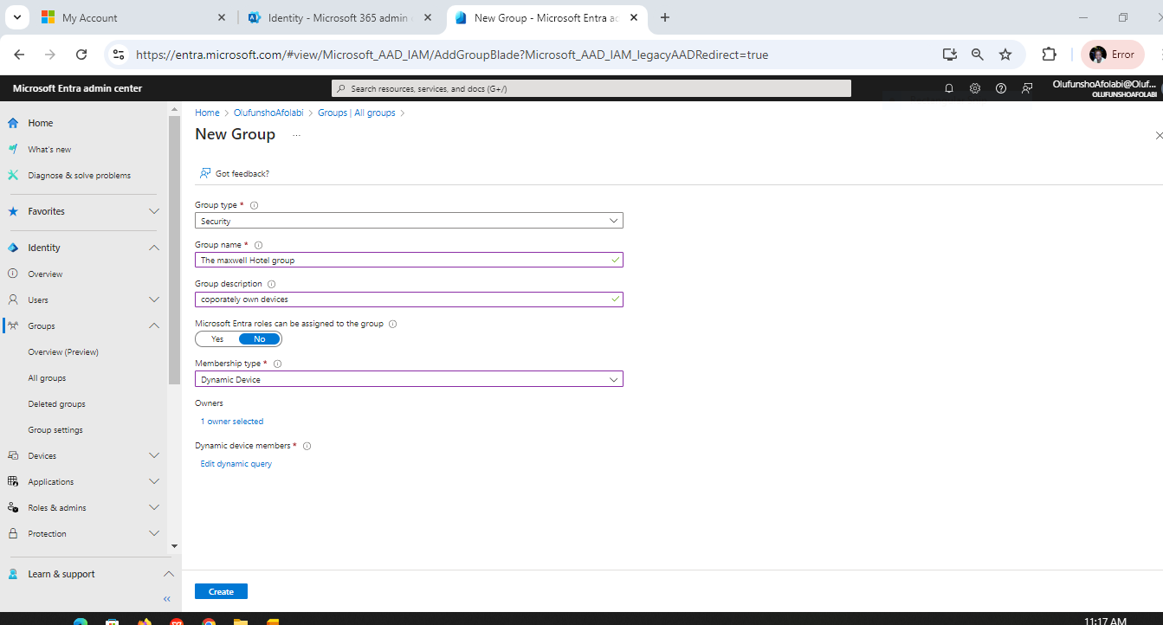
Intune for maxwell hotel

Slide 37
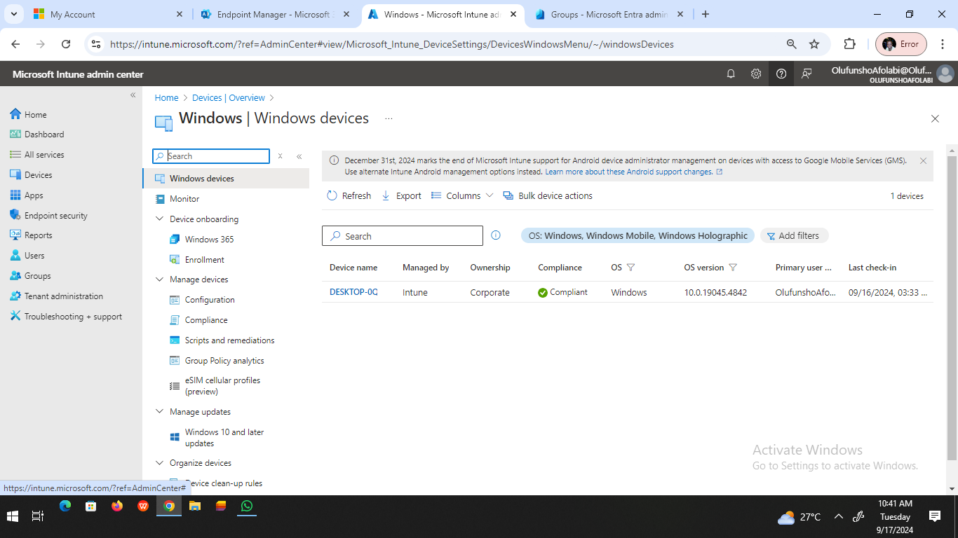
Device compliance check

